Slide 1
Deep CNN Image Classifier
Omar Essa

Slide 2
Overview of Image Classifier
Created a convolutional neural network that trained on many photos of happy and sad people
The label output column returns 0 for happy and 1 for sad
It is able to take new jpeg, jpg, bmp, and png files and predict whether they are photos of a sad or happy person

Slide 3
Prior to Training
Download images of happy people and sad people on Google using the Chrome extension “Download All Images.”
Iterate through them, take them in batches, scale by dividing everything by 255, split into train, validation, and test.
Then, create and compile models using a convolution layer, a maximum pooling layer, flattening everything, and finally a dense layer.

Slide 4


Training
Fit the model and plot the loss and accuracy.

Slide 5
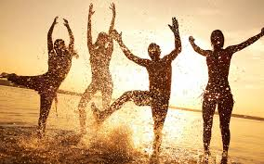

Testing
Finally, print and update the precision, recall, and accuracy for each batch of photos based on predictions on the dataset, and then test the model on new photos and save/load the model.

